Slide 1


ANGULAR and RxJS
CACIB TECHTALK
Notes:
Proceed to next slide

Slide 2
we tend to think
SYNCHRONOUSLY
Notes:
Code that are read from top to bottom
If this then do that else do this

Slide 3
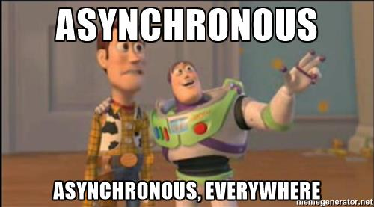
ASYNCHRONOUS
AND
EVENT-BASED
Handling user inputs
Animations
Websockets
APIs
Notes:
But when it comes to front-end devt

Slide 4
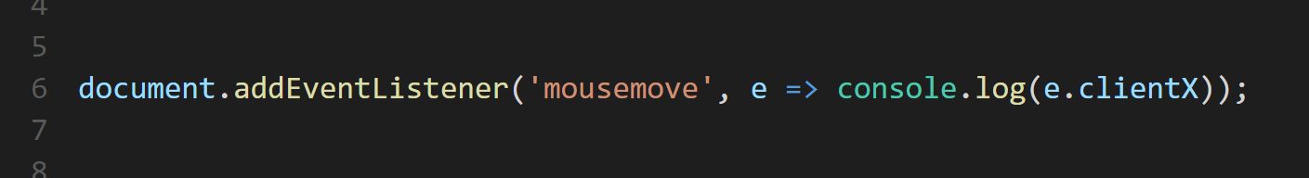

Slide 5
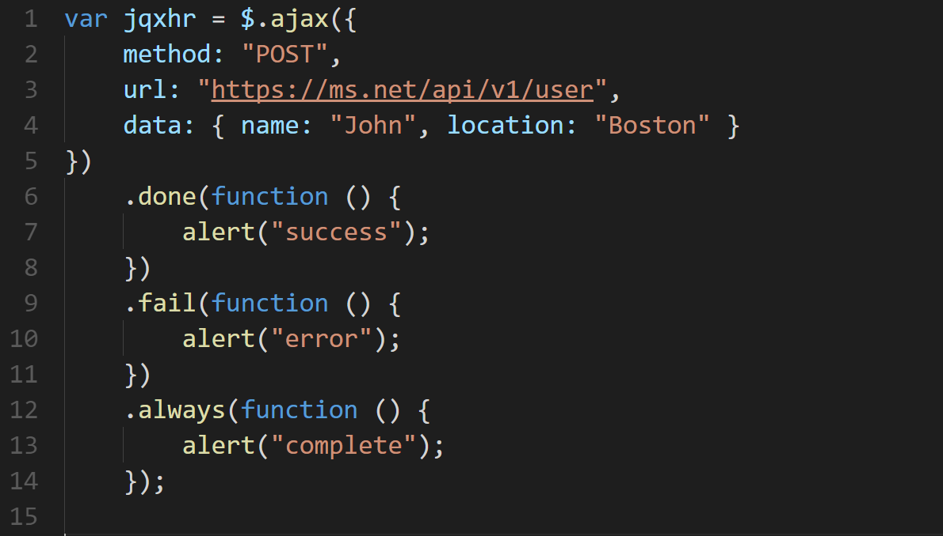

Slide 6
Angular and RxJS Why we want to break Promises
Rogeross Beraña
RFI Software Engineer
CACIB TECHTALK

Slide 7



Slide 8
Client-side Technologies and Concept

